Slide 1

Social decision-making journal club
Thank Dr. Michael Hallquist, director of the DEPENd lab, for sharing this reading list!
The DEPENd lab studies personality functioning using decision neuroscience.
You are welcome to visit
our lab website for more
details!

Slide 2
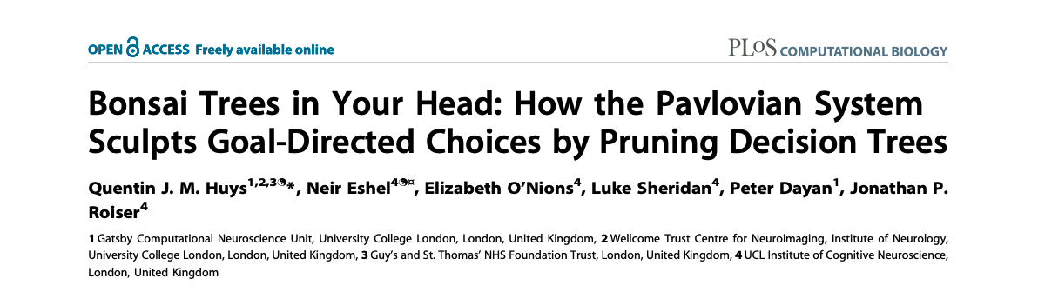
主讲人：马若璠 | Presenter: Ma, Ruofan
2022年2月4日 | Feb 4th, 2022
Find me on: Google Scholar | ResearchGate | Twitter @ma_ruofan

Slide 3
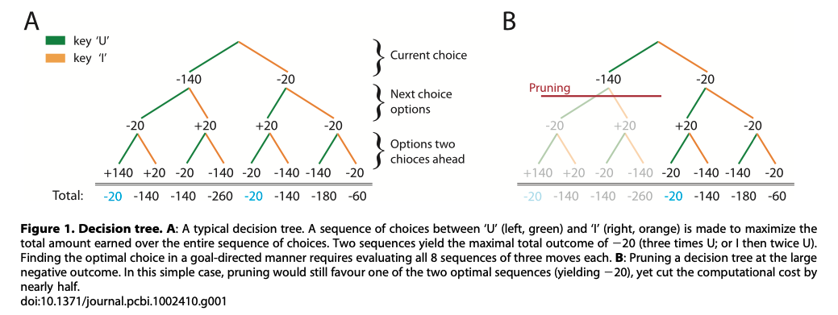
Introduction
Solving decision problems by pruning the decision tree
Computationally costly, limited information, etc.

Slide 4
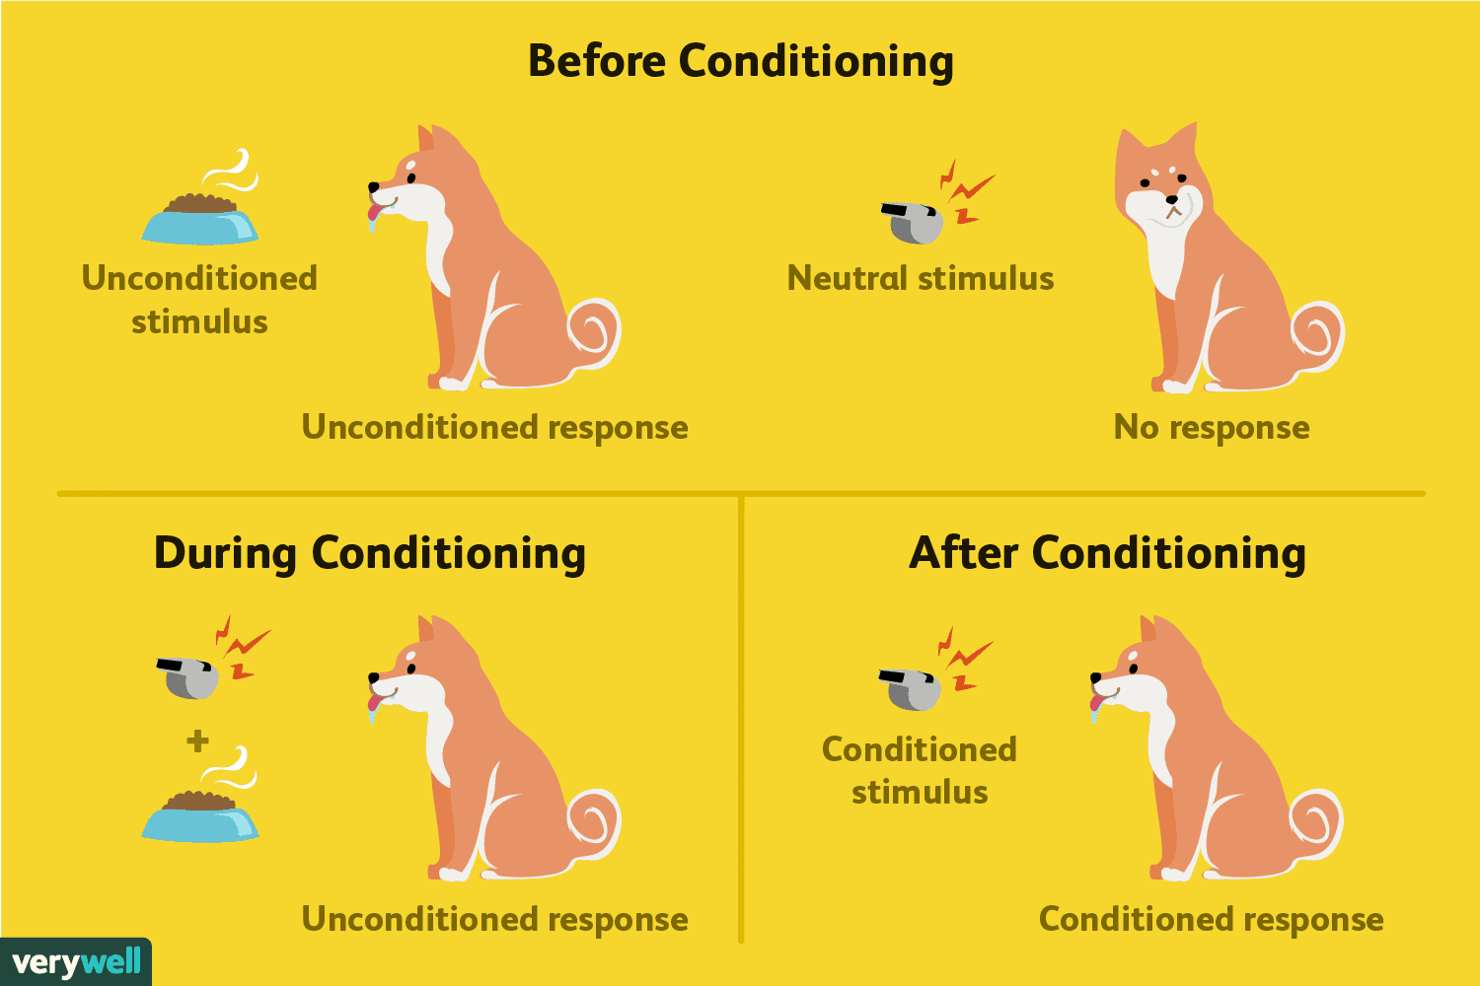
Introduction
“Pavlovian” response:
A reflexive response evoked by a valence (e.g., negative in the decision tree example) in a manner akin to that in which stimuli predicting aversive events can suppress unrelated ongoing motor activity
Responding persists despite being suboptimal
Reward → approach; punishment → inhibition

Slide 5
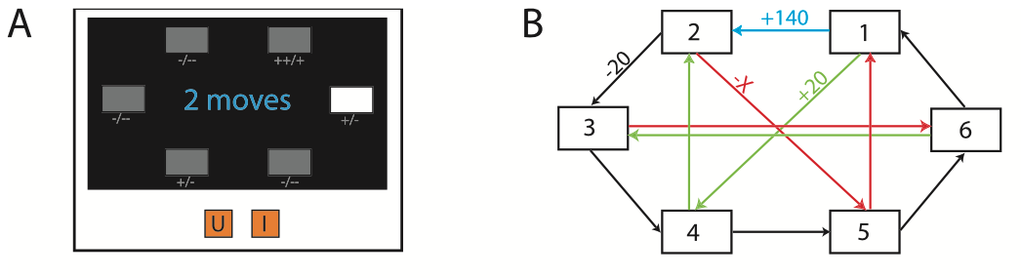
Introduction
Current study:
Is pruning decision trees when encountering losses an instance of Pavlovian behavioural inhibition?
Task:
X (red) value is different across experimental groups (-140, -100, -70)
Notes:
Start at a random state
Navigate between 6 environmental states; from each state, there are two choices they could move to
Each transition/action has a reinforcement value
Generate a sequence of 2-8 choices (sequence length displayed), in each episode
The first 24 episodes are for learning the reward matrix; second 24 episodes are analyzed
(goal: maximize net reward using the required length of moves)
On half of the trials, participants enter their last 2-4 moves without intermittent feedback

Slide 6
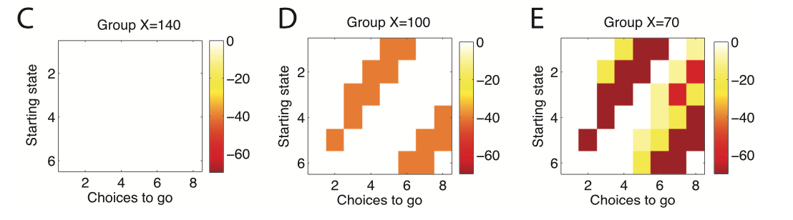
Introduction
Experimental groups:
C: pruning incurs no extra cost
People pruned extensively here, ignoring subtrees lying beyond large losses (-140)
D, E: pruning is counterproductive
Notes:
Color: the best choice sequence with pruning and the best choice sequence without pruning.

Slide 7
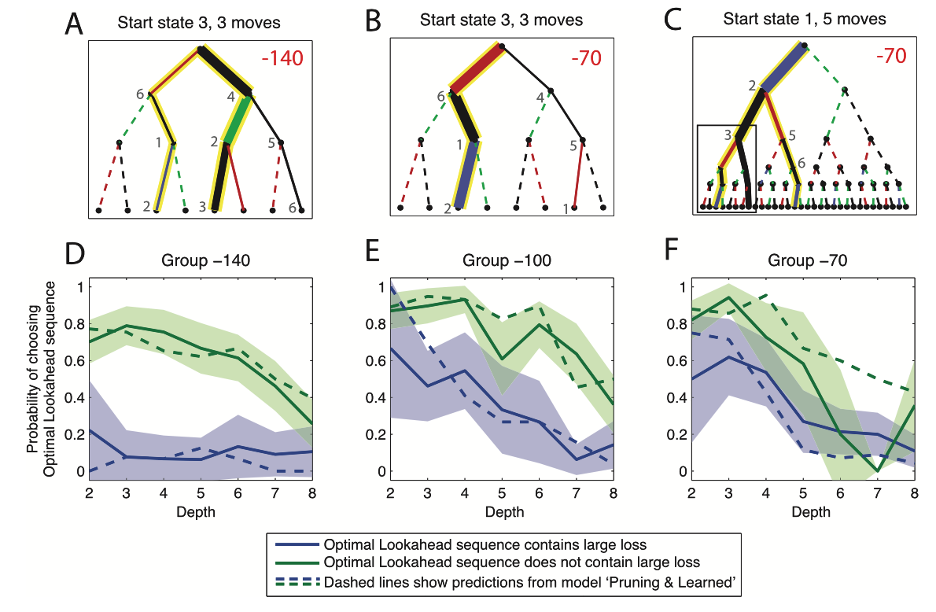
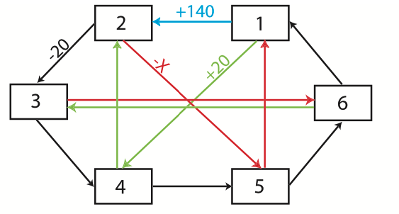
Results
A: people more often avoid the 3-6-1-2 path (pruning), even though the net gain is the same as the other path
B: smaller loss (-70) → less avoidance/pruning, to achieve the optimal gain
C: large loss (-70) is deeper in the tree → fail to avoid sub-optimal pruning

Slide 8
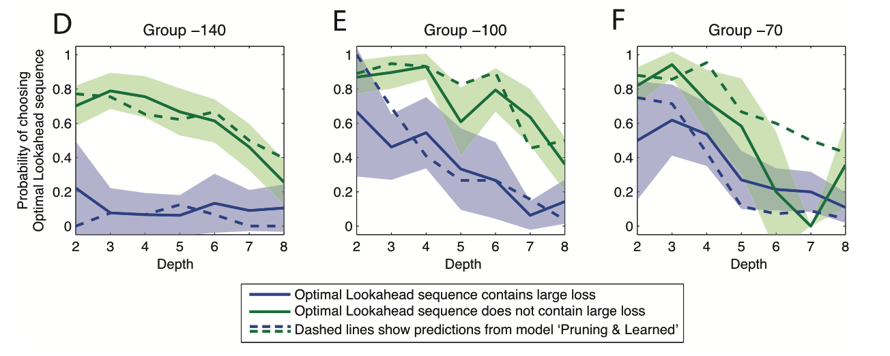
Results
Notes:
- Subjects were also less willing to choose optimal sequences involving transitions through large losses (shown in blue) than those that did not (shown in green).
- Subjects were worse at choosing optimal sequences when the depth was greater

Slide 9
Results
Do subjects neglect the large reward behind the large loss because
They did not even consider looking past the large loss?
Are unable to look so far ahead in the task? (discounting)
They overweight losses relative to rewards? (loss aversion)
They are interfered by other, non goal-directed, decision-making strategies? (conditioned attraction & repulsion)

Slide 10
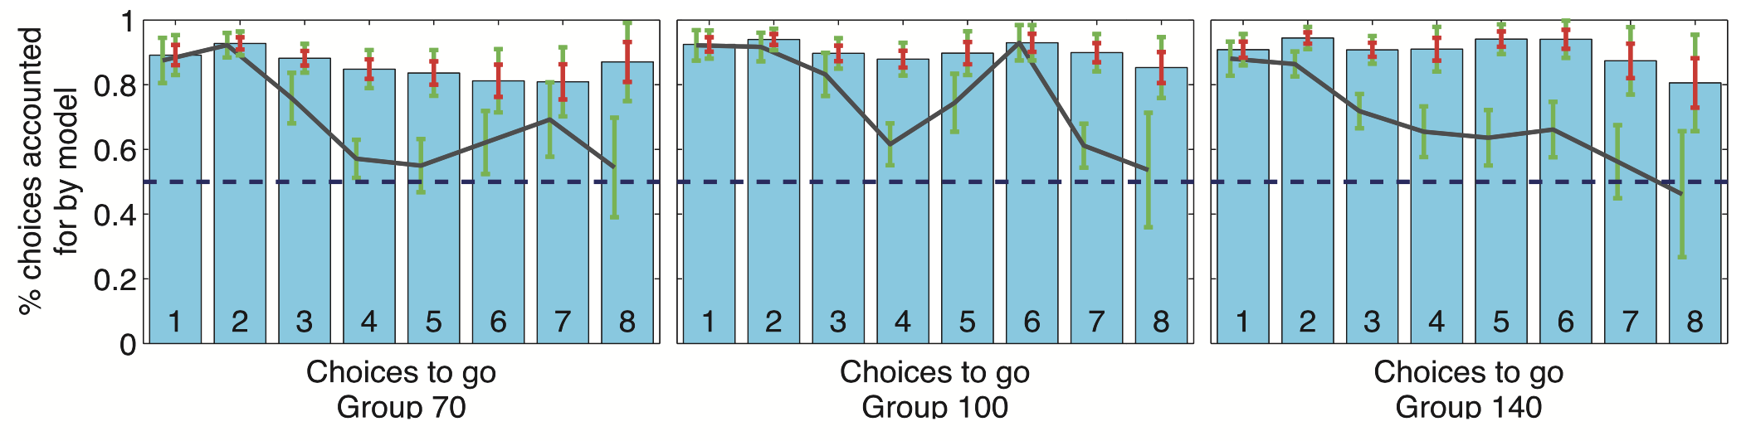
Decision making structure
No pruning (consider all choices)
Higher values → more probable choice
Predicts choices more often than chance

Slide 11
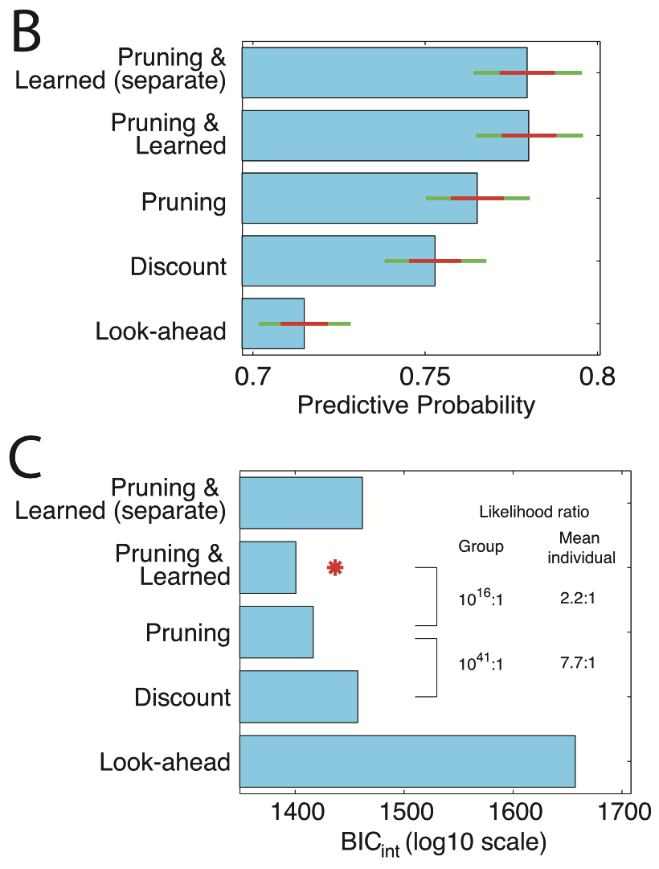
Decision making structure
B: Mean predictive probabilities
Discount: tree search assumed to terminate with probability γ at each depth
the remaining subtree treated as 0
Not planning ahead
Model more parsimonious
Notes:
Mean predictive probabilities, i.e. likelihood afforded to choices on trial t given learned values up to trial t-1.
They did not even consider looking past the large loss?
Are unable to look so far ahead in the task? (discounting) - Model ‘Discount’ attempted to capture subjects’ likely reluctance to look ahead fully and evaluate all sequences
They overweight losses relative to rewards? (loss aversion)
They are interfered by other, non goal-directed, decision-making strategies? (conditioned attraction & repulsion)

Slide 12
Decision making structure
Pruning:
specific pruning parameter γ_{S}: applied to transitions immediately after large punishments (red)
general pruning parameter γ_{G}: applied to all other transitions
Notes:
Mean predictive probabilities, i.e. likelihood afforded to choices on trial t given learned values up to trial t-1.
They did not even consider looking past the large loss?
Are unable to look so far ahead in the task? (discounting) - Model ‘Discount’ attempted to capture subjects’ likely reluctance to look ahead fully and evaluate all sequences
They overweight losses relative to rewards? (loss aversion)
They are interfered by other, non goal-directed, decision-making strategies? (conditioned attraction & repulsion)

Slide 13
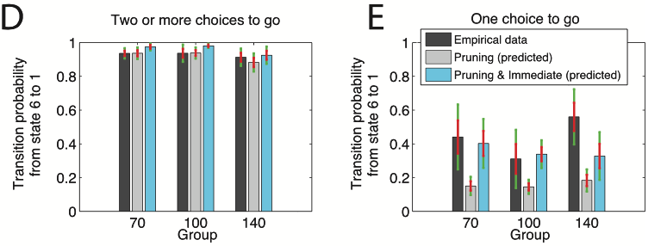
Decision making structure
Pruning & learning:
Accounts for the conditioned attraction/repulsion to states that accrue with experience
Pruning & Learned (separate)
separate models for the three loss groups
No improvement in predictive probability
Notes:
2 choices to go from state 6: best is 6-1-2
1 choice to go from state 1: best is 6-3, but many went to 1 (as if they could get to 2)

Slide 14
Loss aversion
Loss aversion: overweight large losses
Vs. pruning (assign a low value to the path by ignoring a large gain behind a large loss)
Model ”Loss”:
evaluate the entire tree (similar to “look-ahead”)
Infers effective weight that participants assign to each reinforcement
Not better than the Pavlovian pruning models

Slide 15
Correlates with clinical symptoms
Depression (BDI)
Positively correlated with the specific pruning parameter
No correlation with the general pruning parameter
No correlations with neuroticism

